Slide 1
(De-addiction, Reformation & Entrepreneurial Assistance for Making a Safe Society)

Slide 2
Mission:
Our mission is to directly help the addicted victims and prevent others from falling into addiction
Vision:
A safe city capable of satisfying life ambitions of each and every inhabitant free from threats posed by violence and crimes due to drug addiction.

Slide 3
Genesis
Slum
Crime
Drugs
Contextual Reality of Bhubaneswar City

Slide 4
Structure of Team DREAMS

Slide 5
Breaking the Vicious Cycle
Preventive
Social out reach
Social media
Curative
Intervention at Rehab Centre
Restorative
Skill Development
ADP
Community mobilization
Free Treatment & counselling centre
Employment
Self employment
Linkage
Leverage
Identification
Counselling

Slide 6
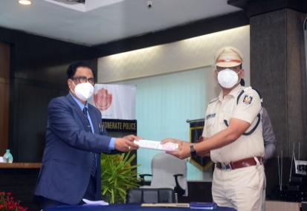
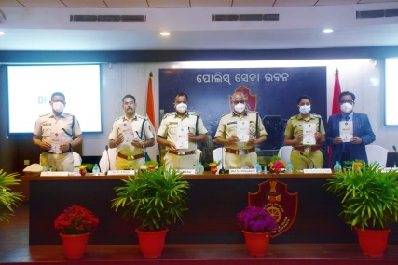
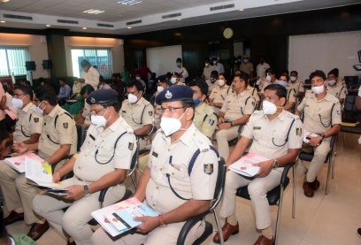
Inauguration
Multi stakeholder consultation & inception workshop
Agreement of Partnership signed between Commissionerate of Police and Indian Institute of Education & Care(IIEC)

Slide 7
Social Outreach
Dreams Title Song
Community meetings in slums
Seminars/workshops at schools/colleges/university
Competitions(Slogan writing, art & debate)
IEC Materials
Radio Talk Show
4000 youths connected with the issue

Slide 8
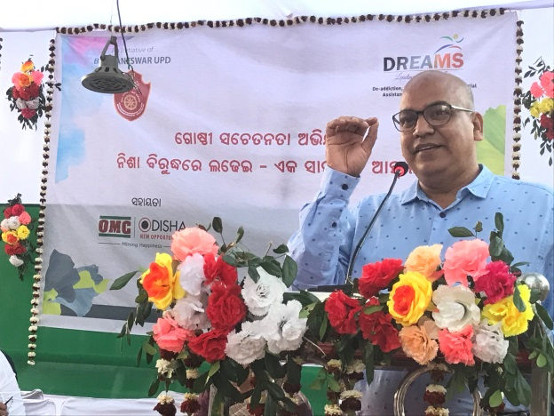
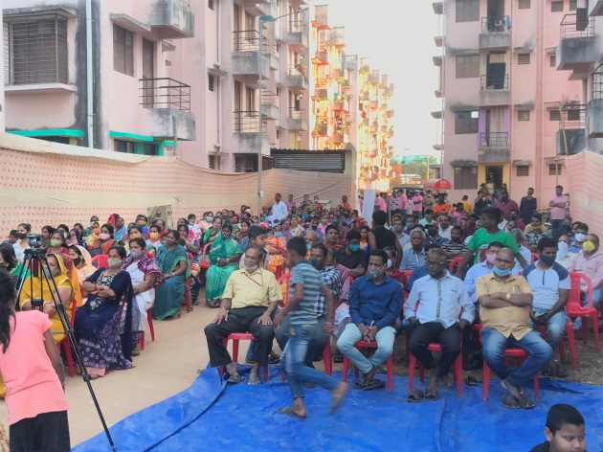
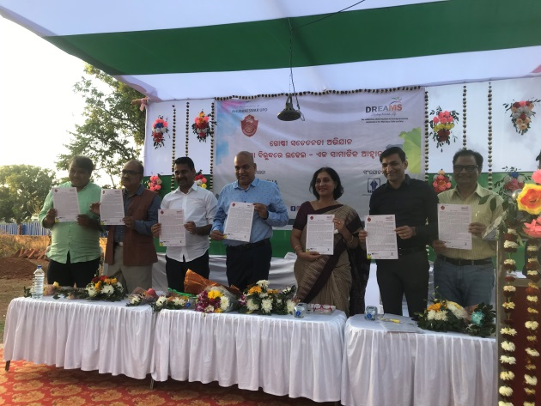
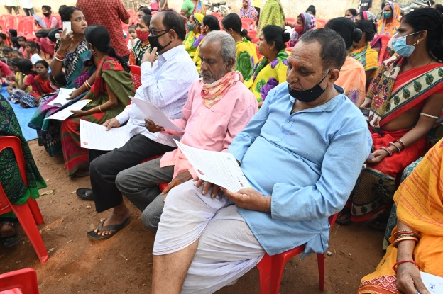
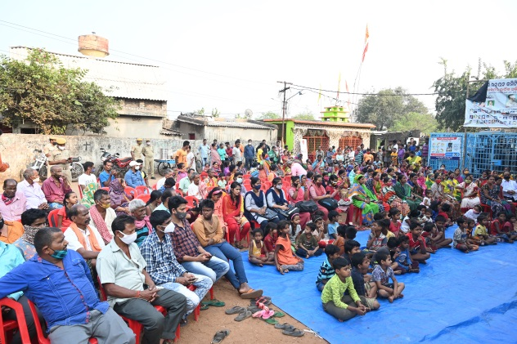
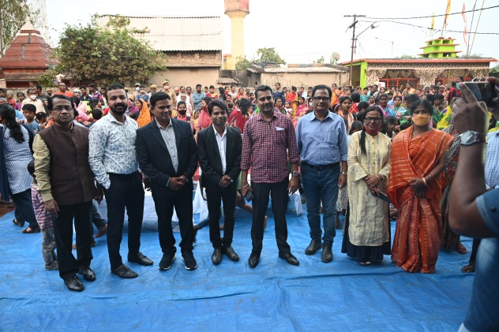
Community meetings in slums

Slide 9
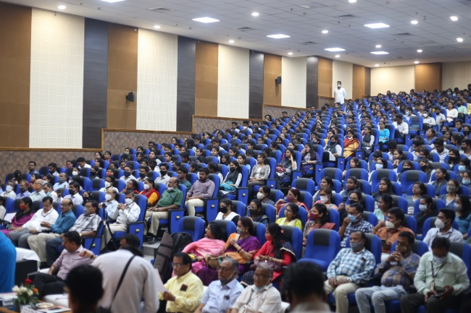
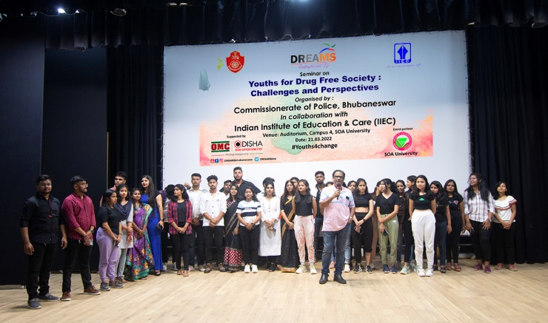
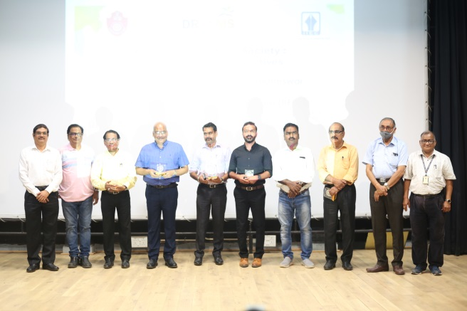
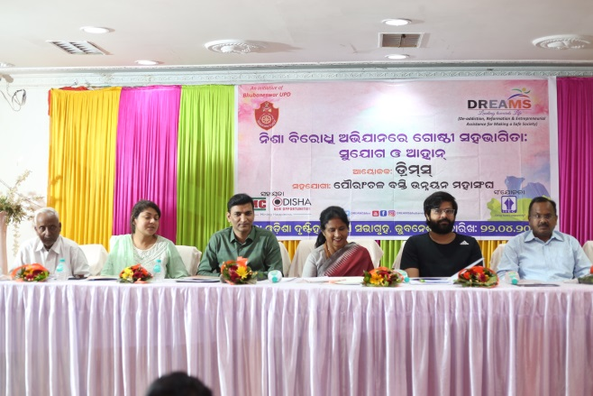
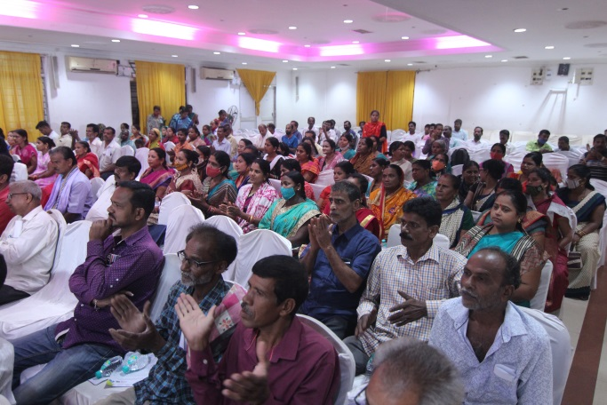
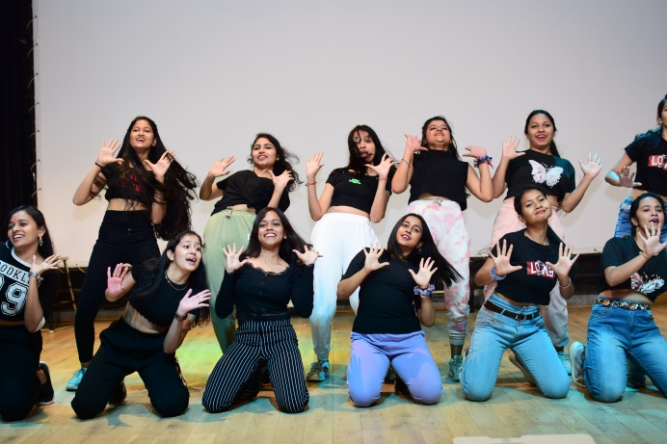
Seminars/workshops at Schools/Colleges/University

Slide 10
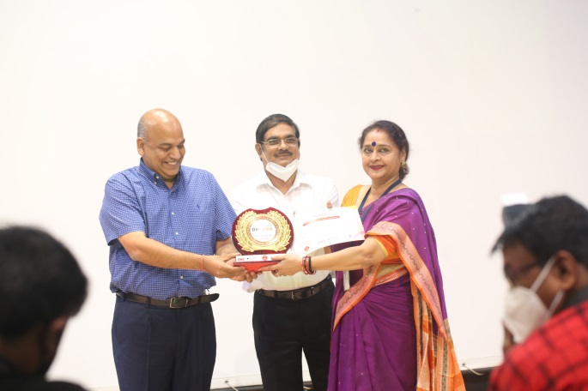
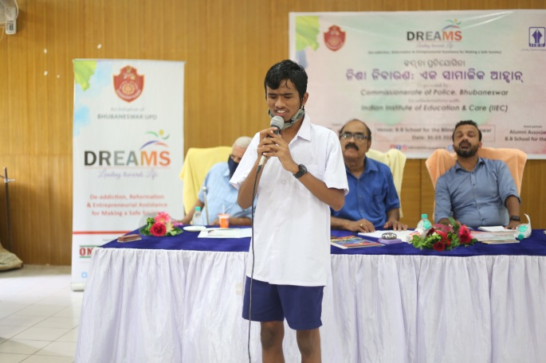
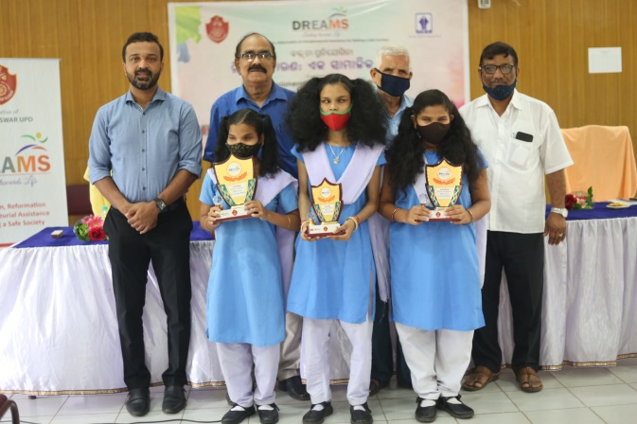
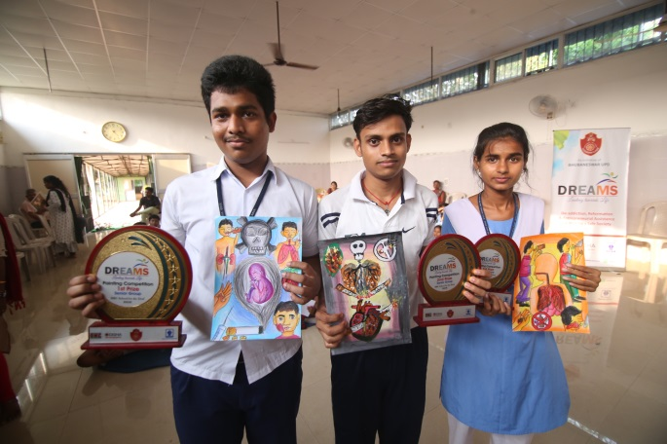
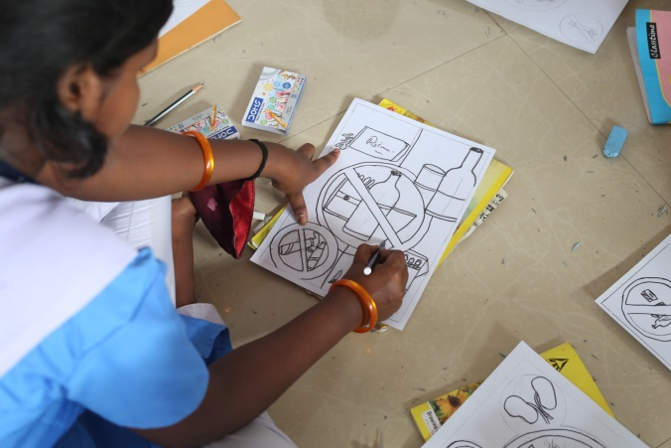
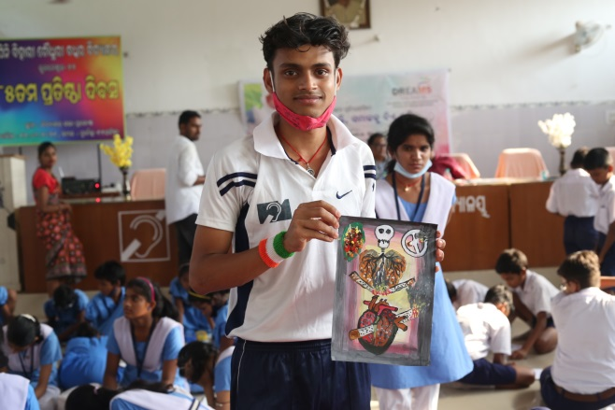
Competitions(Slogan writing, art & debate)

Slide 11
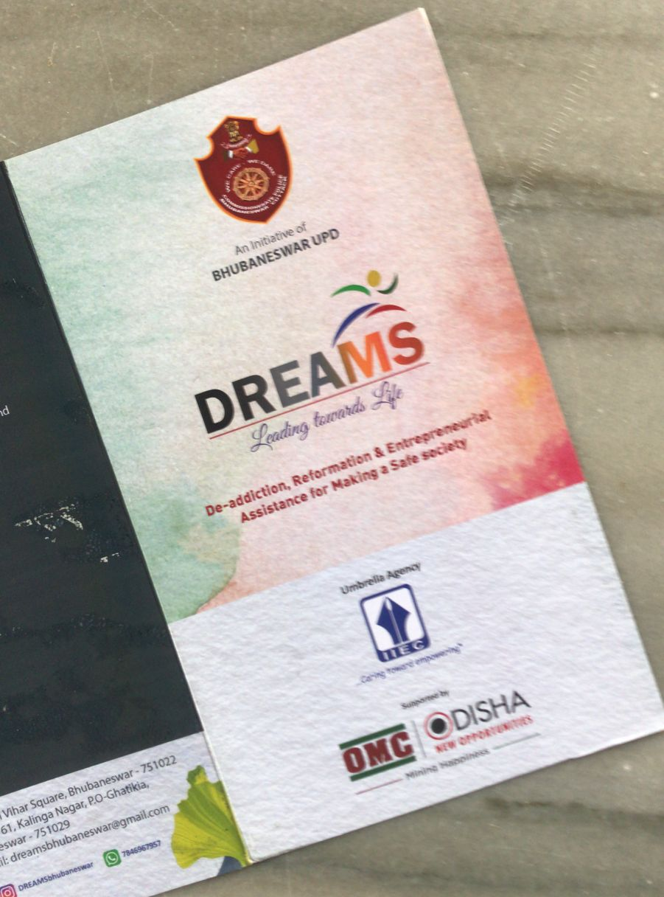
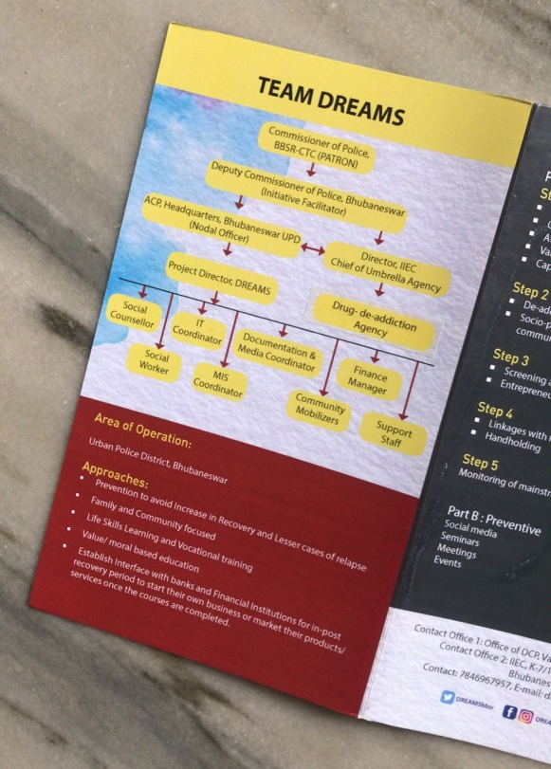
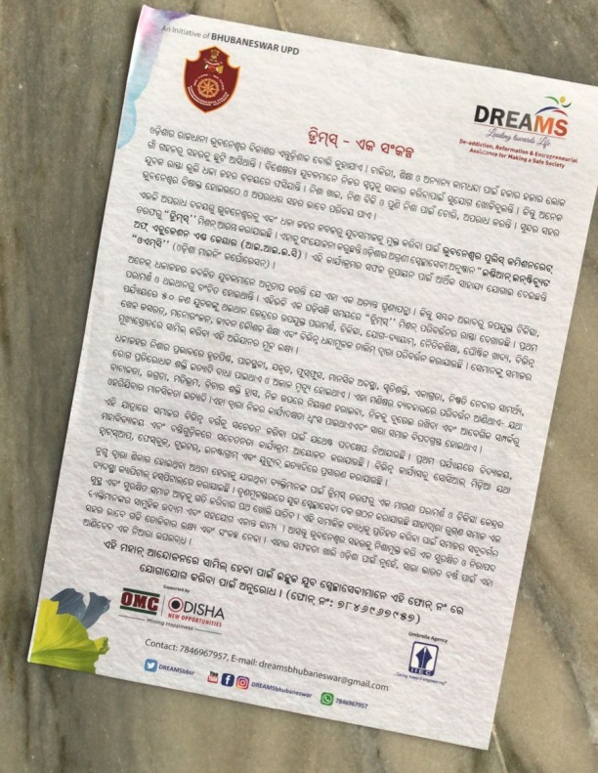
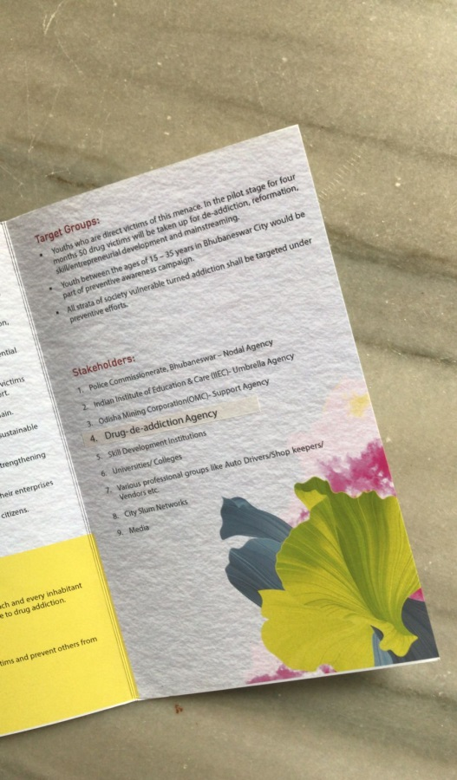
IEC Materials

Slide 12
Community Mobilisation
Household/ FGD/SHGs/Associations/Networks
Counselling by Social worker & Social animators
Task force of volunteers
Awareness by leaflets ,posters, brochure
Motivational speeches and Medical discourses
Cultural shows
Street theater

Slide 13
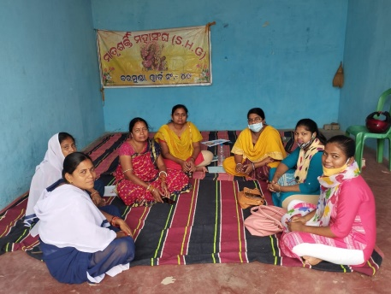
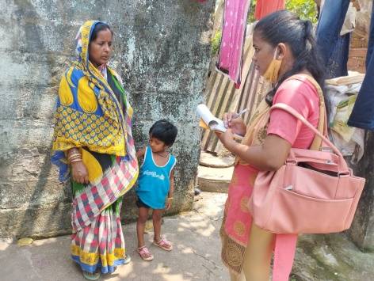
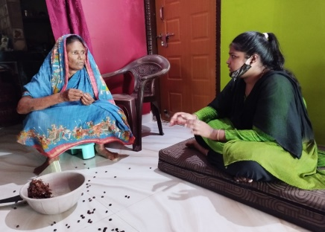
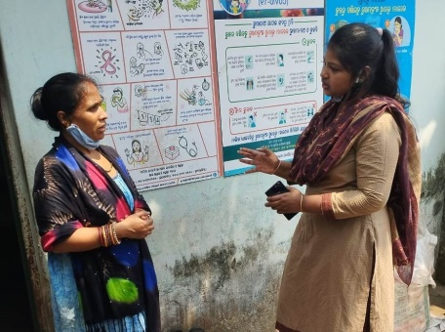
Household/ FGD/SHGs/Associations/Networks
Counselling by Social worker & Social animators

Slide 14
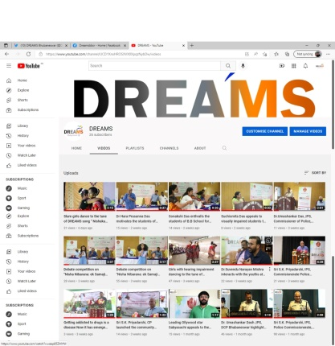
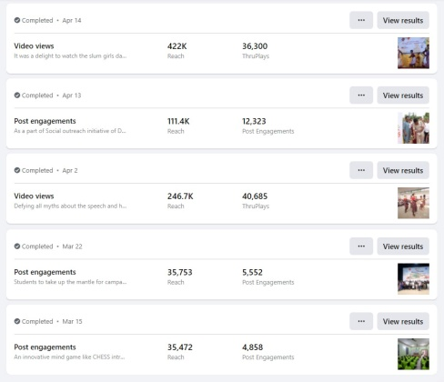
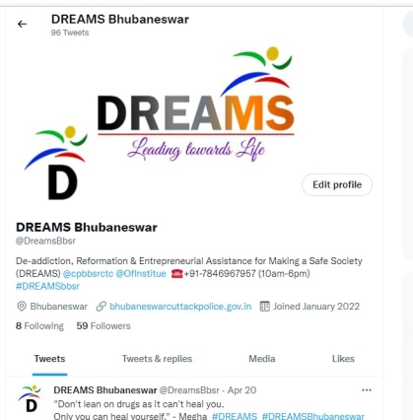
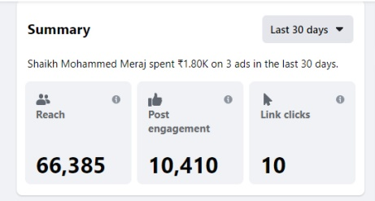
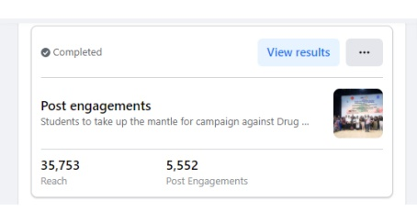
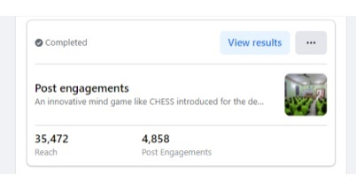
Social Media
Programs & precepts uploaded on Dreams Twitter, Instagram, Facebook & You tube(around 03 lakh population reached as a whole)

Slide 15
Curative
Dedicated helpline number 7846967957 launched
Interventition at Rehab Centre(50 boys)
Out patient treatment & Counselling at Capital Hospital Bhubaneswar

Slide 16
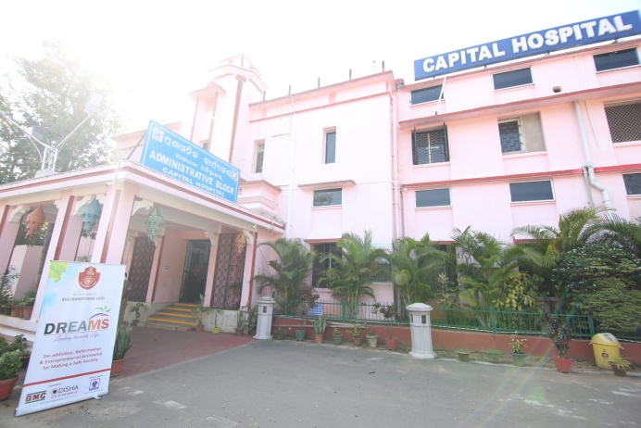
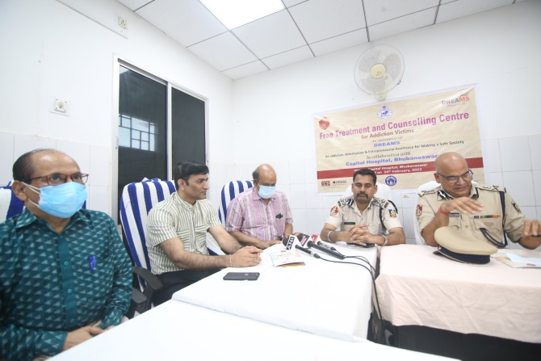
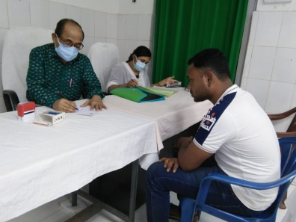
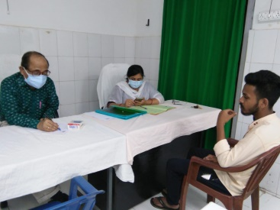
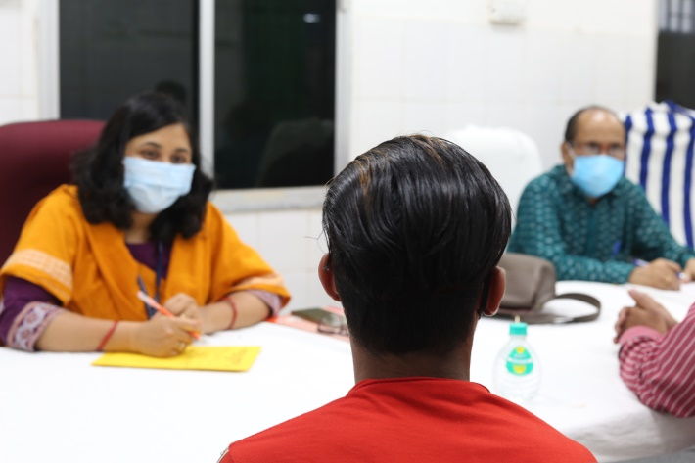
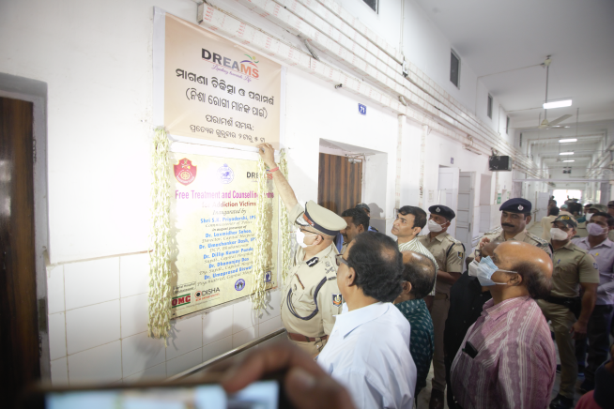
Out patient treatment & Counselling at Capital Hospital Bhubaneswar

Slide 17
Curative
Inputs at Rehab Centre
Medical Detoxification
Therapeutic Treatment
Counselling/ motivational discourses
Spiritual/value education
Life skill education
Occupational & art therapy
Recreation
Indoor games like chess, & carrom etc
Yoga
Narcotics Anonymous teaching
Nutritious diet

Slide 18
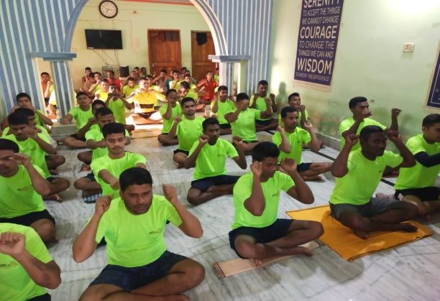
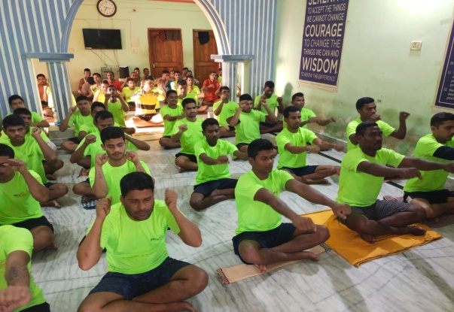
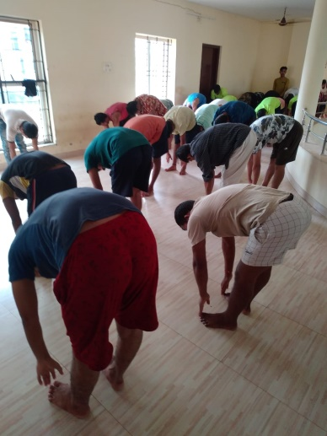
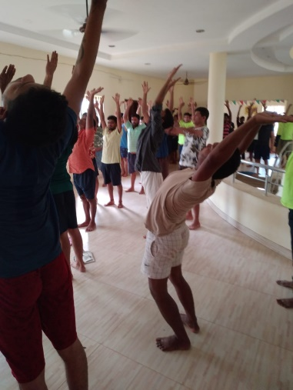
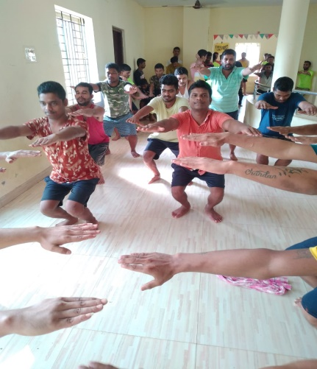
YOGA AND EXERCISES

Slide 19
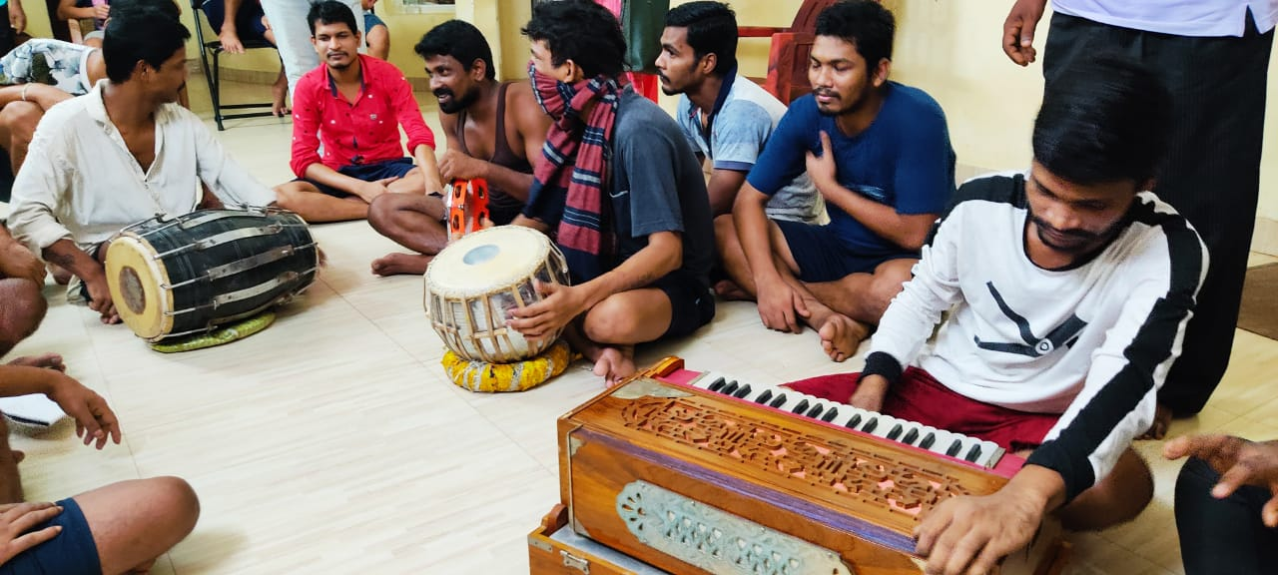
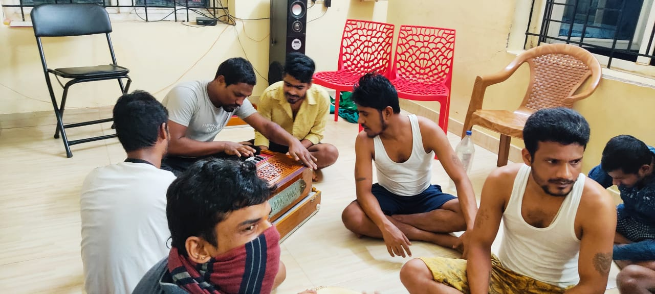
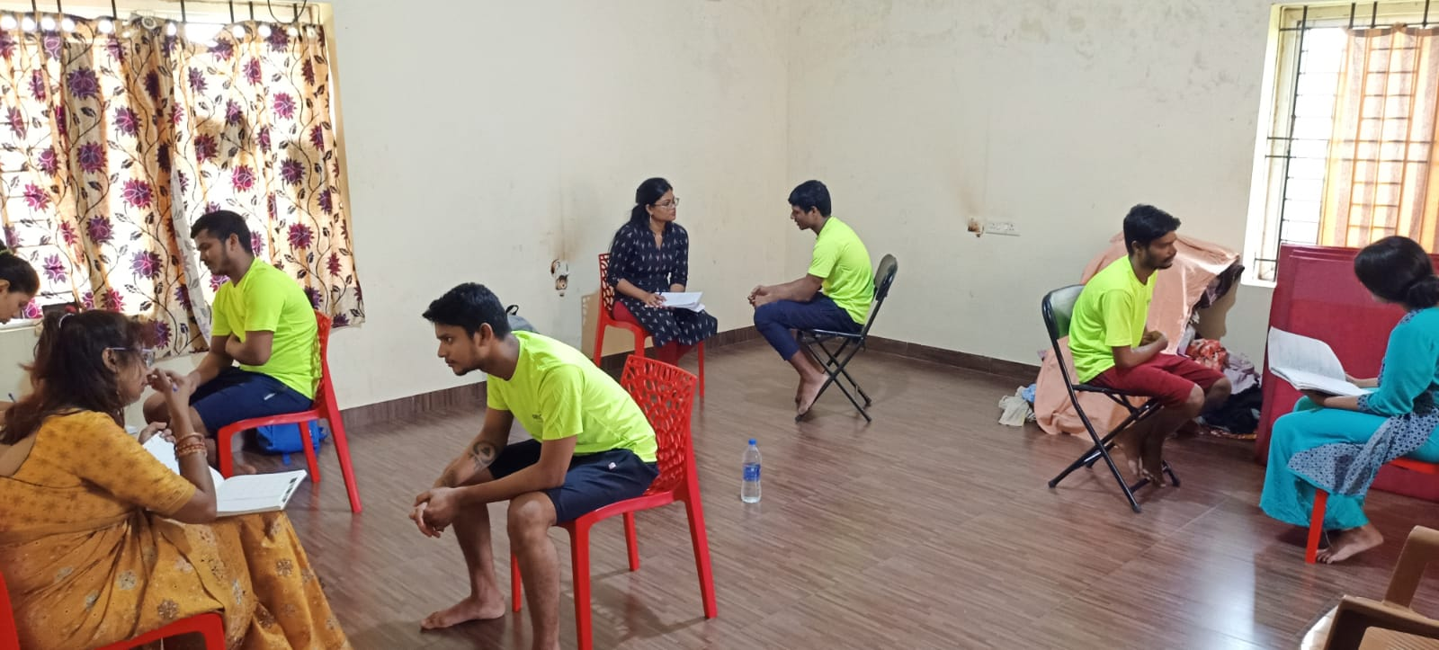
Recreation

Slide 20
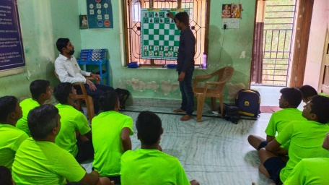
INDOOR GAMES LIKE CHESS, & CARROM ETC

Slide 21
COUNSELLING/ MOTIVATIONAL DISCOURSES

Slide 22
Restorative
Skill Development & EDP
Skill mapping of inmates (50 nos)
Skill training initiated in 5 trades
Collaboration with Khadi & Village Industries Commission(KVIC),Govt.of India to conduct 10 days training in fast food preparation

Slide 23
Collaboration with Khadi & Village Industries Commission(KVIC),
Govt.of India to conduct 10 days training in fast food preparation

Slide 24
Restorative
Post Training Interventions
Self employment in fast food/fruits business
Reemployment of qualified boys in the parent companies
Agreement signed between SAI Foundation Trust & IIEC for engagement of 32 Boys under Garama Garam brand fast food chain.
Zero account of 50 boys opened in ICICI bank
Orientation of boys in digital banking & mobile technology for business transaction
20 carts (food & veg) donated by UCCIL for the selected dreamers.
Rehabilitation of Boys in different parts of Bhubaneswar with carts

Slide 25
Agreement signed between SAI Foundation Trust & IIEC for engagement of 32 Boys under Garama Garam brand fast food chain.

Slide 26
20 carts (food & veg) donated by UCCIL for the selected dreamers.

Slide 27
Rehabilitation of Boys in different parts of Bhubaneswar with carts

Slide 28
Valedictory
Cultural Presentation by Dreamers
Presentation of documentary film on the process of DREAMS
Presentation of memento to the team members of DREAMS
Speeches by Guests
Pledge by Dreamers

Slide 29
Media Clippings

Slide 30
Learning
Criminals with drug addiction background can be mainstreamed with appropriate & adequate rehab interventions
Shelter based rehabilitation at deaddiction centres proves extremely beneficial
Skill development along with employment/self employment opportunities help restore their livelihood and dignity towards socio economic inclusion

Slide 31
Way Forward
Monitoring & evaluation of the young entrepreneurs
Mentoring of boys in groups by management/marketing/business professionals
Successful boys become the torch bearers to sensitize others not to fall prey to drugs
Awareness programs reached schools and colleges extensively & intensively
Advocacy with the Dept. of Education to include the subject of drugs as a part of syllabus
Dissemination of case studies at various levels
Media stories of the best practices
TO regularize Outpatient consultation at Capital hospital
To open DREAMS help Desk at Commissionerate Police, BBSR
To replicate DREAMS initiative in other cities

Slide 32
(De-addiction, Reformation & Entrepreneurial Assistance for Making a Safe Society)
an initiative of Bhubaneswar UPD
Implemented by
Indian Institute of Education & Care (IIEC)
Supported by OMC

